Slide 1
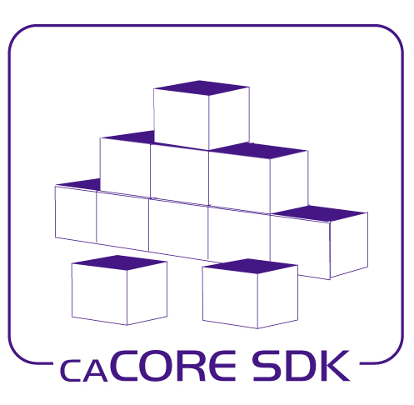

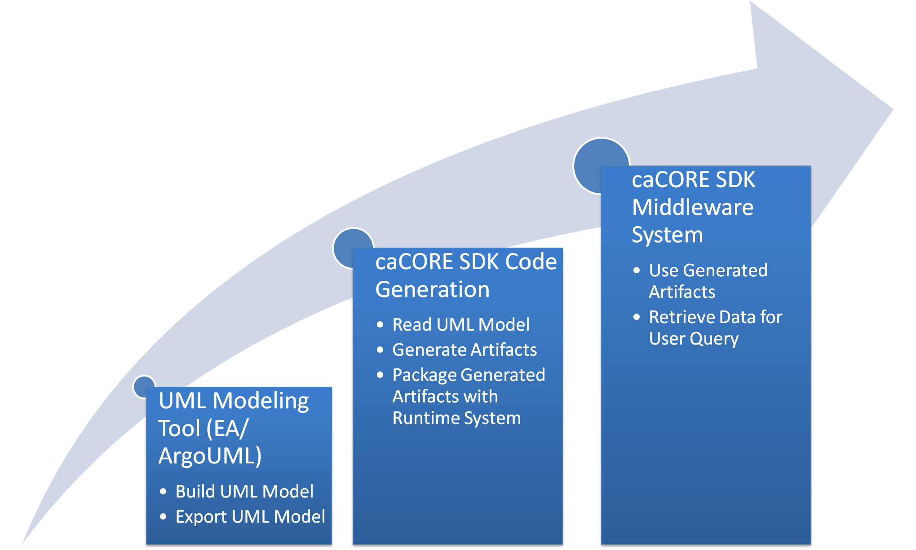












caCORE SDK –
A Framework to Develop Data Sharing Applications
Dan Dumitru, Santhosh Garmilla, Satish Patel - Ekagra Software Technologies
Aynur Abdurazik , Xiaoling Chen - SAIC
David Hau, Sichen Liu, Avinash Shanbhag, Denise Warzel - NCI CBIIT
Ekagra
Overview
The caCORE Software Development Kit (caCORE SDK) is NCI CBIIT’s toolkit that generates a data management framework to allow researchers to navigate through a large number of data sources. A caCORE SDK generated system is built on the principles of Model Driven Architecture (MDA), n-tier architecture and common APIs. This framework allows for easy access to data by other applications in either a secured or a non-secured fashion. When the caCORE SDK generated system is combined with controlled vocabularies and registered metadata, the resulting software system, called “caCORE-like” system, is “semantically integrated”. All exposed API elements of the generated system have runtime accessible metadata defined using controlled terminology.
SDK System Generation Process
SDK Generated Systems on caGrid
Data Service Client
Query
the service
Find service and
Lookup service metadata
Index Service
caGrid
GME
caGrid Data Service
caGrid Data Service
caGrid Data Service
caDSR Data Service
SDK Generated
Service
SDK Generated
Service
SDK Generated
Service
Relational Database
Relational Database
Relational Database
SDK Features
Rapid generation of a caBIG® silver level compatible system
Facilitate caBIG gold level compatible system generation with the caGrid tools
Provides various interfaces to access underlying database
Standardized Query By Example (QBE) based data access interfaces built on the application’s domain model
Supports ArgoUML and Enterprise Architect UML models
Ability to write to the remote data source using Java API
Integrated security with the Common Security Module (CSM)
SDK Generated Middleware System Architecture
Core Services
Registered in
Registered in
Semantically described with terminology from
Object
Definition
WSDL
XSD
Upcoming SDK 4.2 Features
Included with the caCORE workbench to manage multiple code generation and deployment configurations from it’s GUI interface
Single command automated build and deployment for the generated application
Automatically downloads and fully configures a Jboss or Tomcat server as a part of the deployment process
Reconfigures the generated application to deploy into a new environment without regenerating the entire application
Ability to deploy the application in a local or remote machine
Generated By
SDK
Map to
Service Definition
Validate against
SDK Service API
SDK Client API
Grid Service
Generated by Introduce
Grid Client API
Java API
Client App
Oracle
Database
Read/Write
Java Interface
Objects
XML
Objects
MySQL
Database
Read/Write
Objects
Objects
Java API
WSDL
XSD
Client uses
Service Definition
CSM
Security
Database
Web Service Interface
Validate against
Checks
Web Service
Client uses
Further Information
SDK Website: https://cabig.nci.nih.gov/tools/caCORE_SDK
SDK Users Mailing List: CACORE_SDK_USERS-l@list.nih.gov
HTTP Interface
XML
Internet Browser
CLM Log
Database
Logs
HTTP/REST
XML/ HTML

